Slide 1
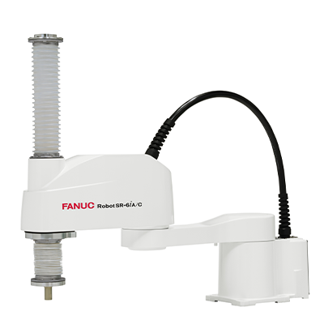

Drives, Controls and Modelling Laboratory (MTE 3161) ➡
MODELLING, SIMULATION AND CONTROL OF SCARA(RRP) MANIPULATOR ARM
SUBMITTED BY
Bhavya Doshi -210929184
Shantanu B. – 210929106
Abhishek Biswas - 210929276
MINI PROJECT

Slide 2
OBJECTIVES
The increasing prevalence of robots in modern industrial production emphasises how important it is to research robotic arms as essential instruments in this field. Our goal is to study the modelling and simulation of SCARA robotic arms in various contexts. In theory and in simulated conditions, this investigation could make robots achieve greater flexbility and be able to do more in the industrial settings.
The manipulator follows predefined trajectories that are tailored to certain purposes. Many methods, such as forward and inverse kinematics, have been used to guarantee accurate arm motion. Furthermore, PID tuning has been applied to optimise the arm's performance. In addition, motors are used for control, which makes it possible to carry out a variety of activities precisely and effectively.

Slide 3

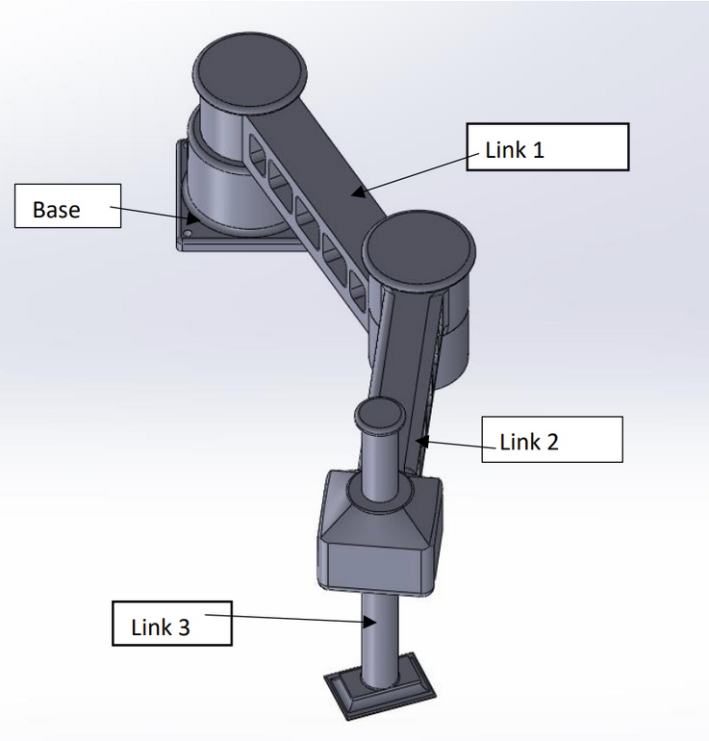
ABOUT SCARA
THE SCARA ACRONYM STANDS FOR SELECTIVE COMPLIANCE ASSEMBLY ROBOT ARM OR SELECTIVE COMPLIANCE ARTICULATED ROBOT ARM.
Scara is a type of Industrial robot.
The SCARA robot is most commonly used for pick-and-place or assembly operations where high speed and high accuracy is required.
Generally a SCARA robot can operate at higher speed and with optional cleanroom specification

Slide 4
Overview of the Project
1
2
3
4
5
6
STEP
STEP
STEP
STEP
STEP
STEP
Making CAD Model of a SCARA
Transfering the CAD model into Simscape Module
Applying Inverse and Forward Kinematics
Adding and Tuning PID Controller
Adding the Parameters,
Trajectories and Testing them
Tuning the controllers with dc motors

Slide 5
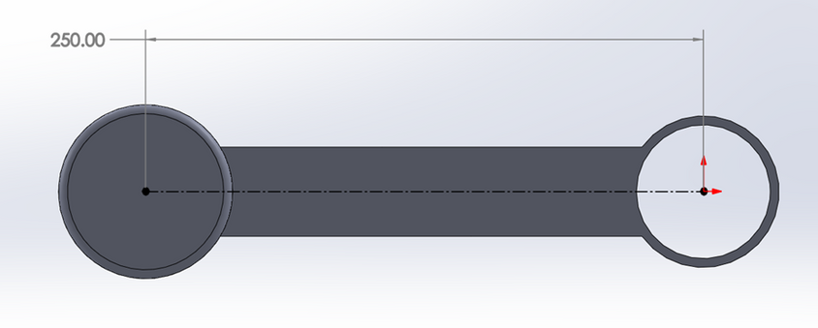
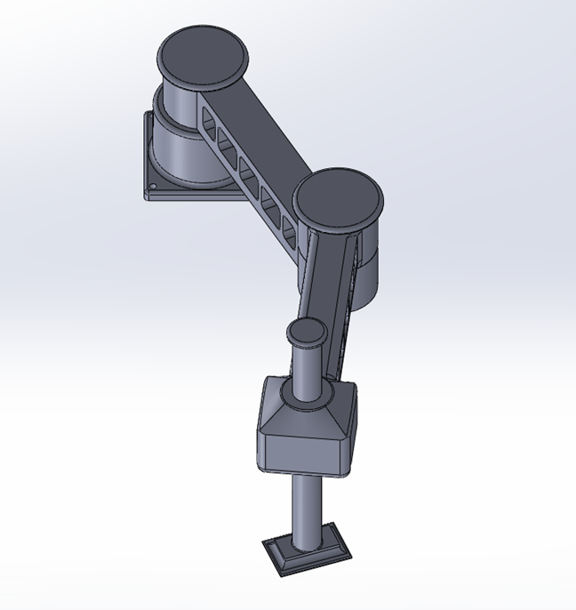
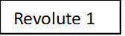
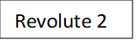
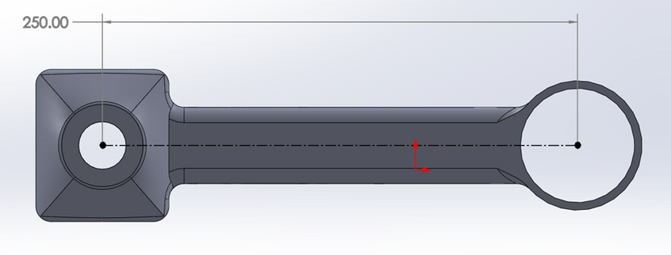
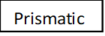
MAKING CAD MODEL OF A SCARA
Link 1
Link 2
Link dimensions
Joints

Slide 6
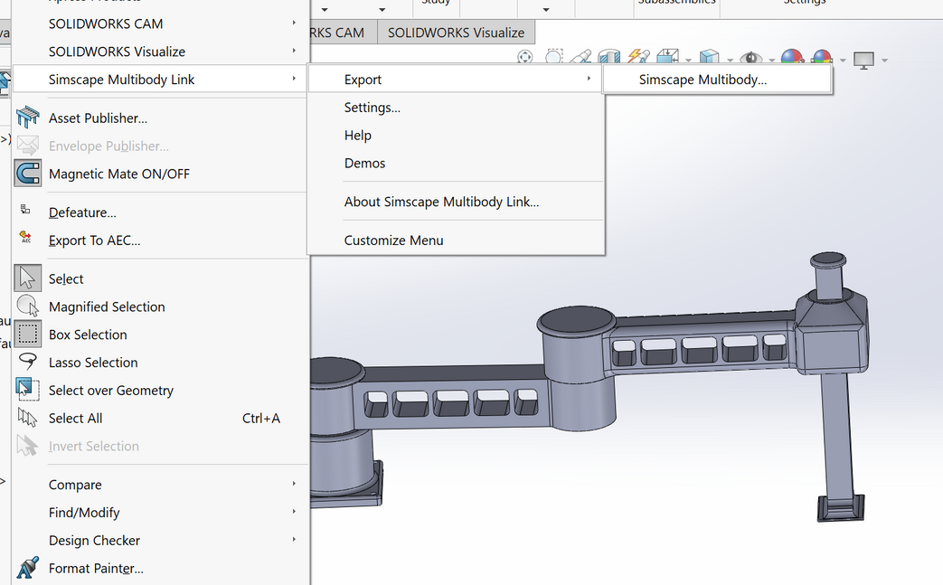
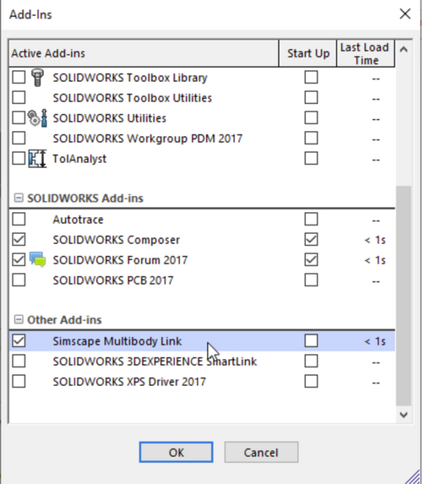

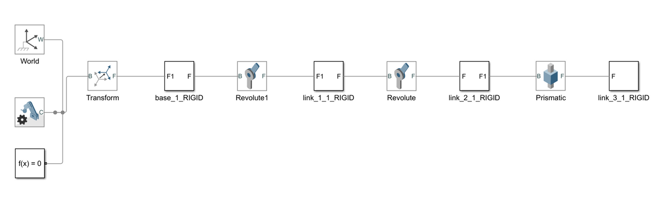
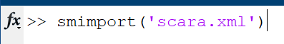
TRANSFERING THE CAD MODEL INTO SIMSCAPE MODULE
smlink_linksw
Imported model in Matlab

Slide 7
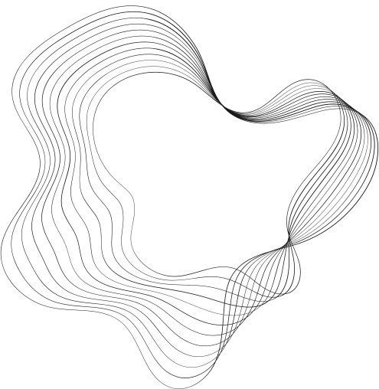
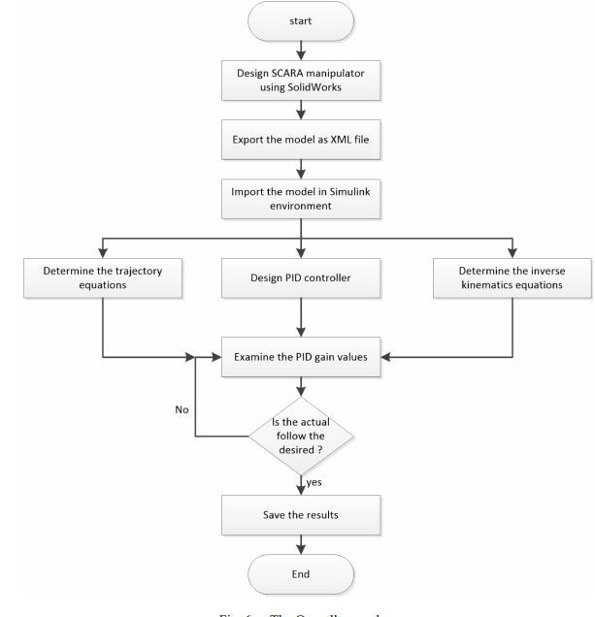
PROCESS FLOW

Slide 8
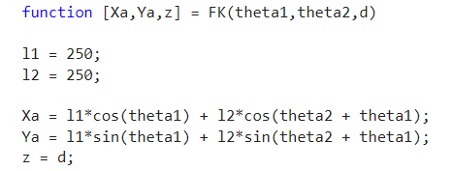
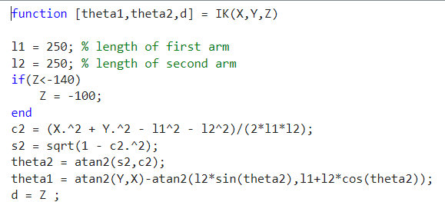
SIMULATION AND Modelling
Added Kinematics and Inverse Kinematics function blocks
Forward Kinematics
Inverse Kinematics

Slide 9
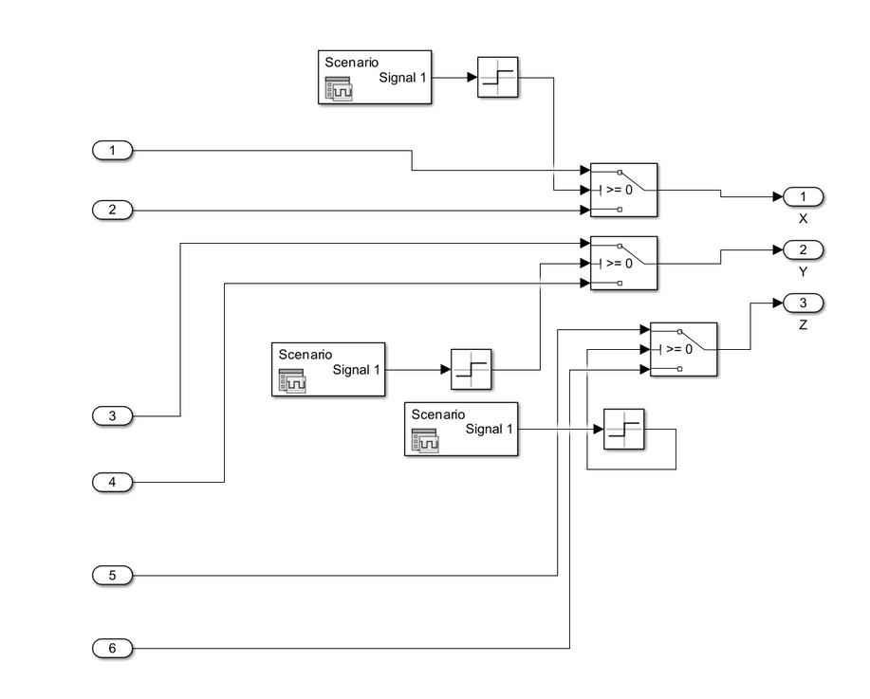
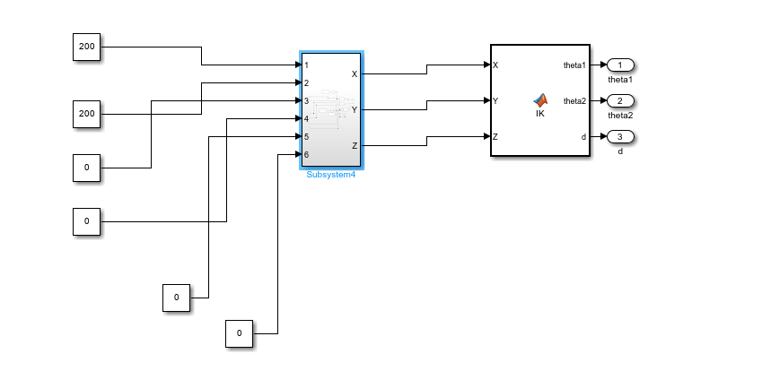
Provided input coordinates to inverse kinematics block
Using Signal Editors and switches the desired coordinates were given in order to visualise the motion of the robot
this method of using the signal editors and switches would make debugging easier

Slide 10
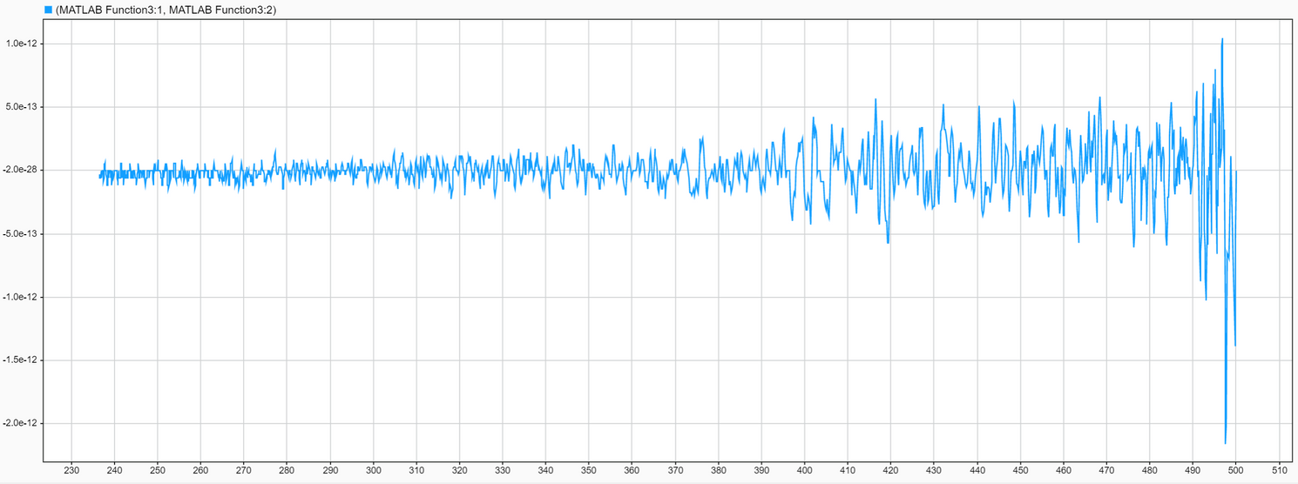
Tuning the System (before adding motors)
Result of XY graph of tuned Scara Manipulator
We tuned the Model before adding the motors to visualise the ideal condition and compared it further after adding the motors
First, we changed and tuned the P value till the steady-state error was achieved and to reduce the error we tuned the I value
We tuned the D value to reduce the oscillation.

Slide 11
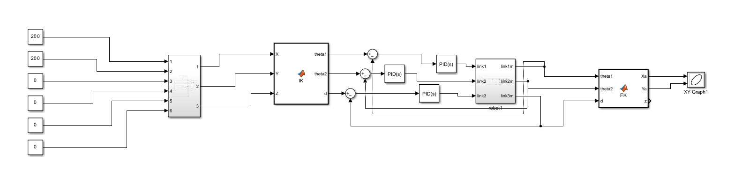
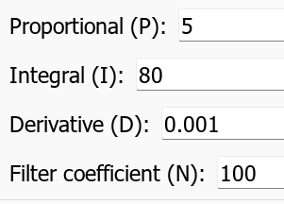
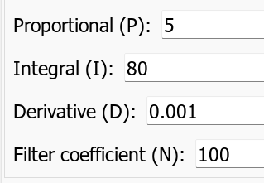
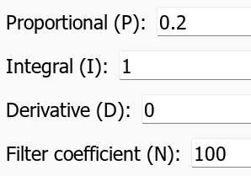
Tuning
PID model 1
PID model 2
PID model 3

Slide 12
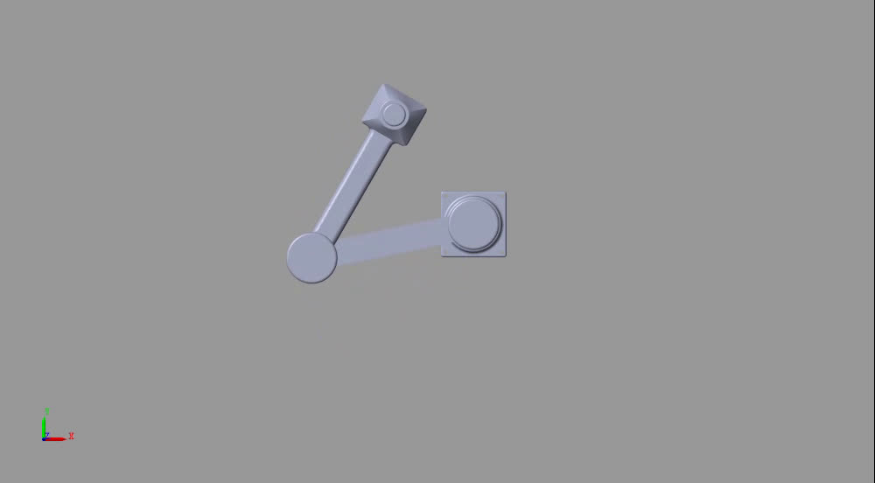
SIMULATION
Moving the Bot from (500,0) Coordinate to (200,0)->(0,200)
The end effector covers an angle of 90 degree.

Slide 13
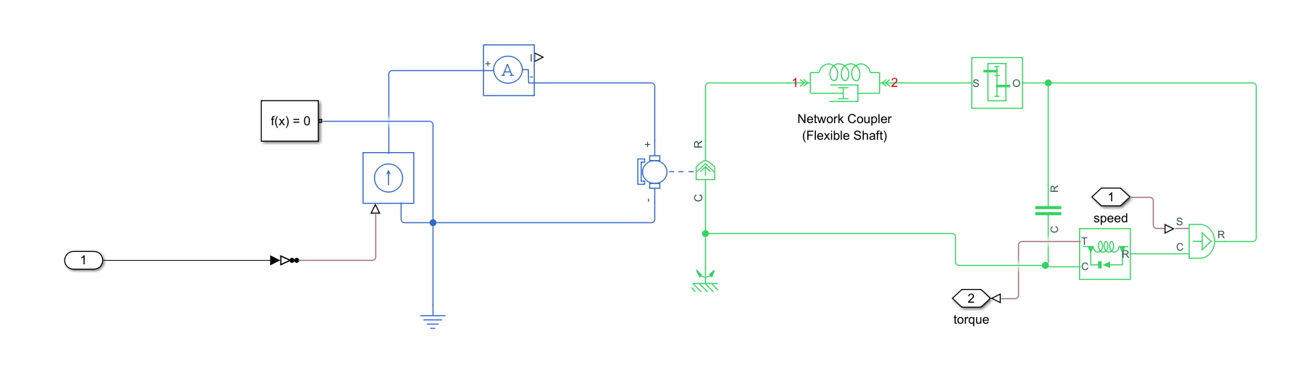
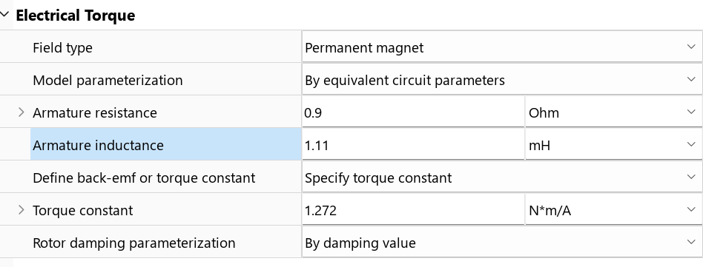
Adding Motors
IG-45 a industrial grade DC motor is chosen for the application of Manipulator
it is cost effective and robust and has great accuracy and control while its motor drivers are also easily available and comparatively lighter

Slide 14

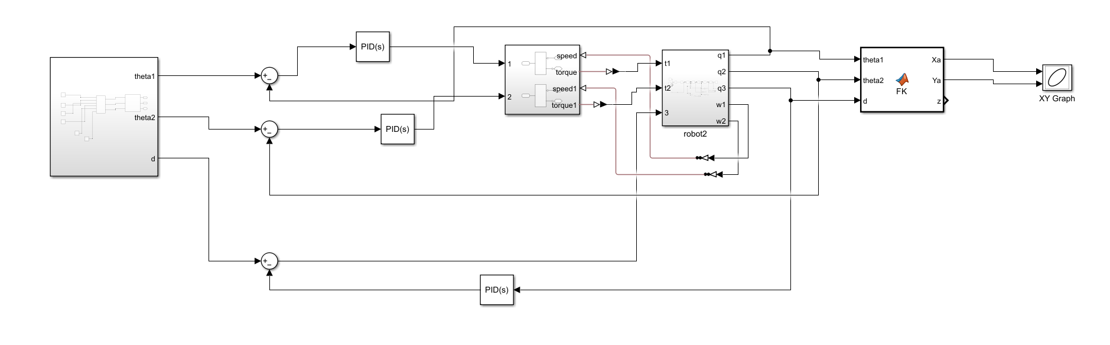
Final Model

Slide 15
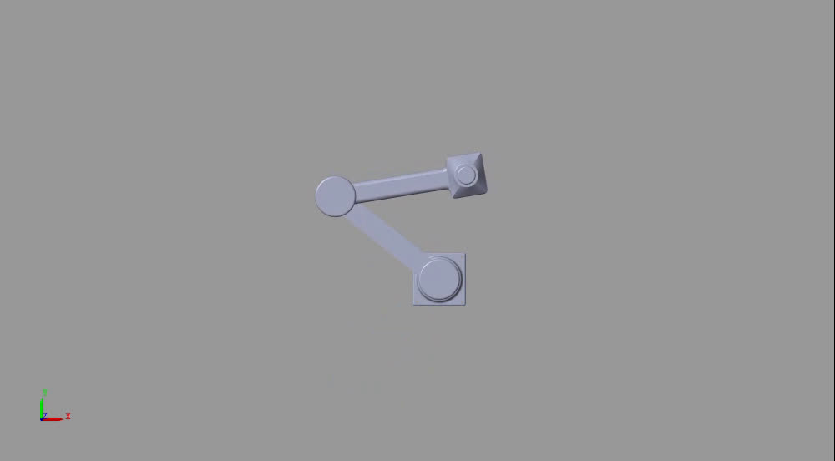
SIMULATION (AFTER ADDING MOTOR)
Moving the Bot from (500,0) Coordinate to (200,0)->(0,200)
The end effector covers an angle of 90 degree.

Slide 16
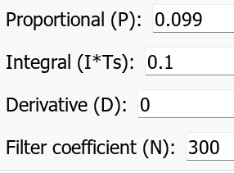
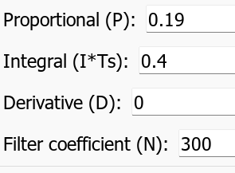
Tuning it again
PID model 1
PID model 2
PID model 3

Slide 17
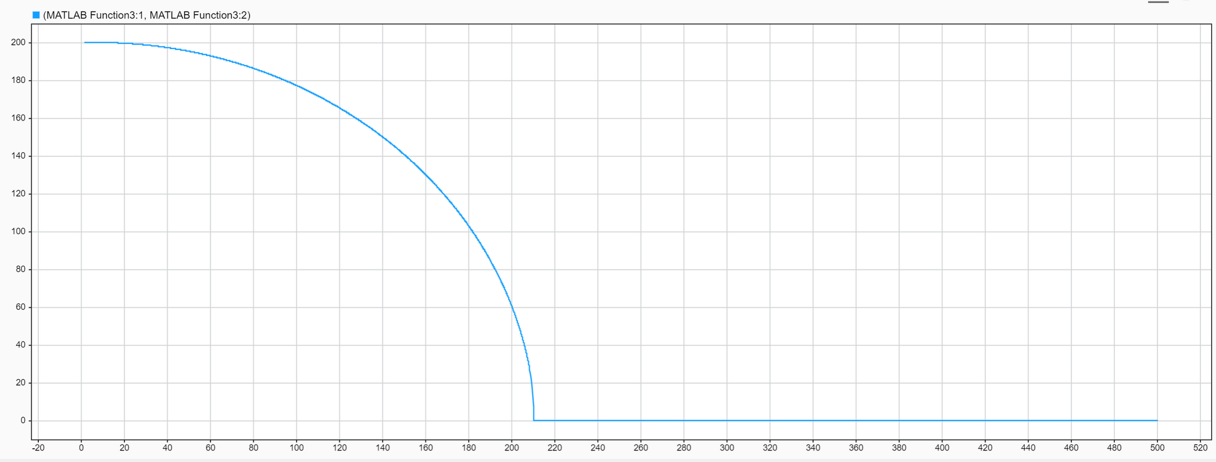
Result and Conclusion

Slide 18
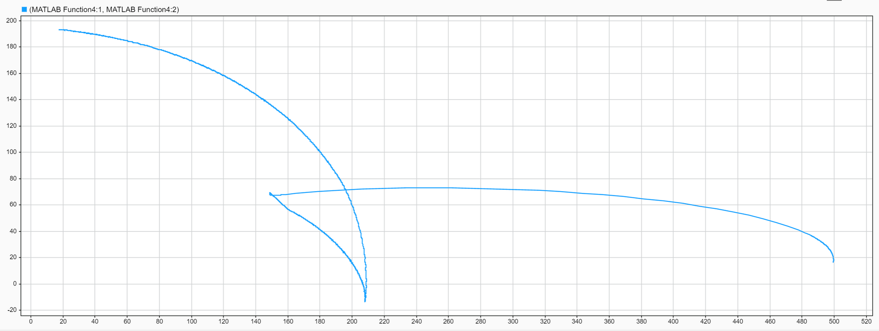
Result and conclusion

Slide 19
FUTURE SCOPE
THESE DC MACHINES CAN BE TUNED BETTER BY USING CONTROLLERS LIKE FUZZY LOGIC CONTROL
MORE DETAILED ANALYSIS CAN BE PERFORMED AFTER VARYING THE VOLTAGES AND CURRENT PROVIDED TO THE MOTOR WHICH IS THE REAL LIFE SCENRIO
A BROADER PERSPECITVE ON HOW DIFFERENT MOTOR APART FROM BRUSHED DC MOTOR LIKE SERVO OR STEPPER MOTOR CAN BE USED TO GET FURTHER CONCLUSIONS

Slide 20
Contribution
Bhavya Doshi
Shantanu Baranwal
Abhishek Biswas
Setting up the model on Matlab, converting the coordinates to angles using Inverse Kinematics, PId tuning and control of Model, making of PPT and report
Setting the Cordinate System of the links of CAD model, Using Simcape Multibody Link Plugin to Convert CAD to XML file, Generating Simscape Multibody Model of the CAD,Configuring Joints,PPT and Report
Making CAD model of scara in SolidWoks, Writing Forward Kinematics code, Adding and configuring motors and its control and PID tuning, Coordinates generator, PPT and Report

Slide 21
➡ DAS, TAYLAN & DÜLGER, LALE. (2005). MATHEMATICAL MODELLING, SIMULATION AND EXPERIMENTAL VERIFICATION OF A SCARA ROBOT. SIMULATION MODELLING PRACTICE AND THEORY. 13. 257-271. 10.1016/J.SIMPAT.2004.11.004.
➡HTTPS://WWW.YOUTUBE.COM/WATCH?V=PDIWAA1CNB0&T=2790S&PP=YGUGBW9KZWXSAW5NIG9MIHNJYXJHIGFYBSBPBIBTYXRSYWI%3D
REFERENCES
➡J. LIU AND Q. LUO, "MODELING AND SIMULATION OF ROBOTIC ARM IN MATLAB FOR INDUSTRIAL APPLICATIONS," 2019 11TH INTERNATIONAL CONFERENCE ON INTELLIGENT HUMAN-MACHINE SYSTEMS AND CYBERNETICS (IHMSC), HANGZHOU, CHINA, 2019, PP. 346-349, DOI: 10.1109/IHMSC.2019.00086.
➡ HTTPS://NRSYED.COM/2018/01/21/HOW-TO-READ-A-DC-MOTOR-DATASHEET/
➡ HTTPS://WWW.YOUTUBE.COM/WATCH?V=S3O5ZRS6DDC

Slide 22
THANK YOU

